Slide 1

Artificial Intelligence Knowledge Representation and Reasoning
Dr. Pratibha C. Kaladeep (Dr. Pratibha S. Yalagi)
(pratibhayalagi@gmail.com )
Department of Computer Science and Engineering,
Walchand Institute of Technology,
Solapur.
www.witsolapur.org

Slide 2
Course Outcomes
- At the end of this course, students will be able to…
Formulate and solve sequence of actions for an agent as a search problem.
Infer from represented knowledge using logical and probabilistic reasoning methods
Solve agent decision problems using probability theory
Comprehend forms of learning and demonstrate their working.

Slide 3
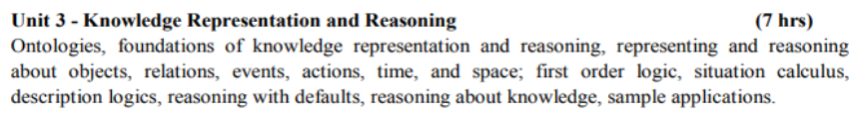
Contents to be discussed

Slide 4
What is Ontology?
It is a data model that represents knowledge as a set of concepts within a domain and the relationships between these concepts.
It comes from two Greek Words.
Onto: Existence or Being Real
Logia: Science or Study
The word is used in two settings:
Philosophical
Non Philosophical

Slide 5
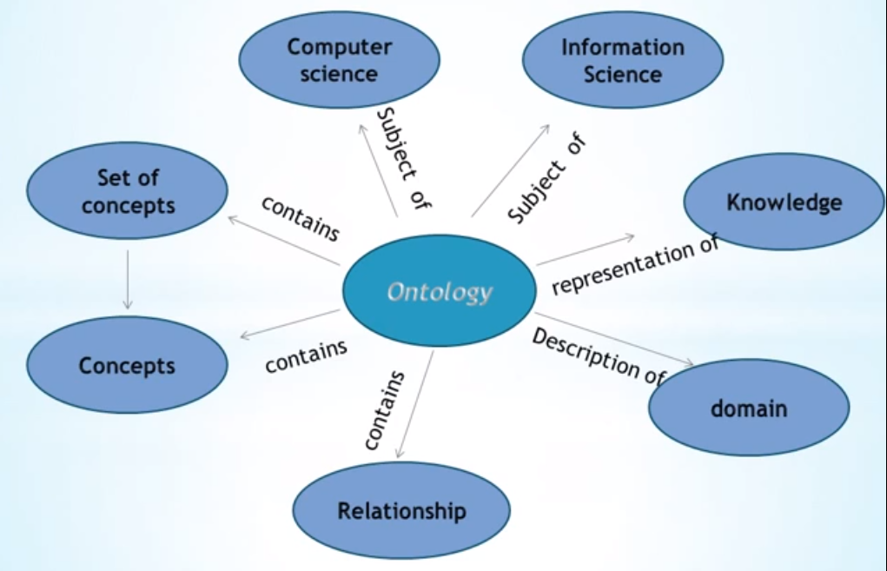
What is Ontology?
Class
relationship

Slide 6
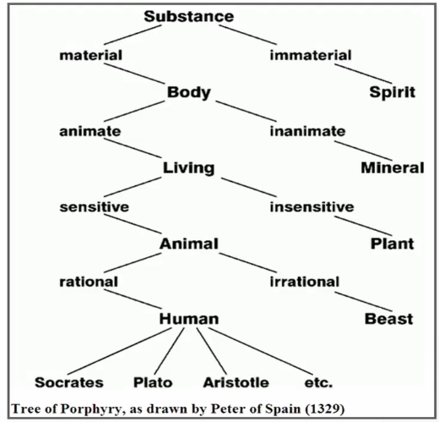
What is Ontology? – Philosophically
Ontology is a term used by the philosophers to mean the most “Essential Existence” in the universe.
Eg: A human life
Parmenides was the first the propose an ontological characterization of the fundamental nature of reality
Provides a definitive and exhaustive classification of entities in all spheres of life

Slide 7
What is Ontology in Computer Science?
Definition: Ontology in Computer Science and Information Science encompass a representation or formal naming and definition of categories, properties and relationship between the Concepts.
It is a branch of Computer Science where we deal with representation of Knowledge or Information in a machine.
It refers to a shared vocabulary for researchers. It includes machine-interpretable definitions of basic concepts and the relationships between them.
Ontology-based AI allows the system to use contents and the relationships between them to make inferences that emulate human behaviour.
It can produce targeted results and does not require training sets to become functional.

Slide 8
What is Ontology in Computer Science?
Knowledge represented in a formal way.
A hierarchy of concepts within the domain
A shared vocabulary to denote the types
Properties and interrelationship between those concepts
Def: “An ontology is a specification of conceptualization that is designed for reuse across multiple applications and implementations. A specification of conceptualization written, formal description of a set of concepts and relationships in a domain of interest”.(Peter Karp, 2000)
Def: “The arrangement of kinds of things into types and categories with a well-defined structure”. (Passin, 2004)

Slide 9
Ontology Vs Knowledge Base
An ontology is a formal representation of a domain of knowledge. It is an Abstract Entity, it defines the vocabulary for the domains and the relationship between the concepts. But, an ontology says nothing about how the knowledge is being stored(as physical file, in a database or in other some form) or how it can be accessed.
A Knowledge Base(KB) is a physical artifact, it is a database, a repository of information that can be accessed and manipulated in some predefined fashion. The knowledge in the knowledge base can be said to be modelled according to an ontology.

Slide 10
Types of Ontology
Upper
Level
Ontology
General
Ontology
Domain
Ontology

Slide 11
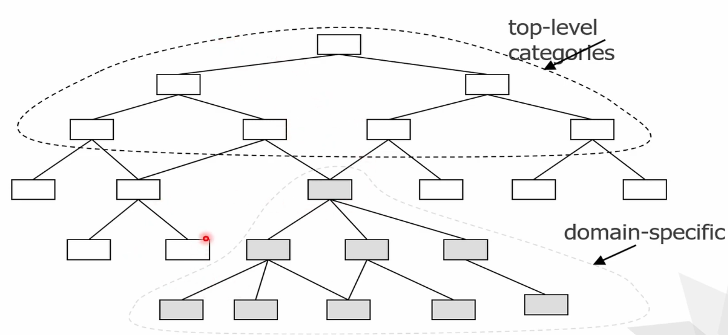
Types of Ontology

Slide 12
Types of Ontology
Upper Level Ontologies: An Upper Level Ontologies also called as top level Ontologies describe the most general concepts that are the same across all the knowledge domains (Eg.: Entities)
General Ontologies: Represent the knowledge at an intermediate level of details independently of a specific task. (Eg.: Theories of Time and Space)
Domain Level Ontologies: Designed for a specific tasks and is also called as application ontologies.

Slide 13
Types of Ontology
University
Engineering
Commerce
Arts
Civil
BBA
B.Ed
CSE
MBA
M.Ed
ENTC
Mech

Slide 14
Knowledge Representation and Reasoning
Knowledge representation means represent knowledge about the world in a manner that facilitates inferencing (drawing conclusions) from the knowledge.
Knowledge representation and reasoning (KR², KR&R) is the field of AI dedicated to representing information about the world in a form that a computer system can utilize to solve complex tasks such as diagnosing a medical condition or having a dialog in a natural language.

Slide 15
Knowledge Representation and Reasoning
It incorporates findings from psychology about how humans solve problems and represent knowledge in order to design formalisms that will make complex systems easier to design and build.
KR&R also incorporates findings from logic to automate various kinds of reasoning, such as the application of rules or the relations of sets and subsets.

Slide 16
Knowledge Representation and Reasoning
Following are the kind of knowledge which needs to be represented in AI systems:
Object: All the facts about objects in our world domain. E.g., Guitars contains strings, trumpets are brass instruments.
Events: Events are the actions which occur in our world.
Performance: It describe behaviour which involves knowledge about how to do things.
Meta-knowledge: It is knowledge about what we know.
Facts: Facts are the truths about the real world and what we represent.
Knowledge-Base: The central component of the knowledge-based agents is the knowledge base. It is represented as KB. The Knowledge-base is a group of the Sentences (Here, sentences are used as a technical term and not identical with the English language).

Slide 17
Types of Knowledge representation
Types of Knowledge representation
Logic / Logical representation
Rules / Production Rules
Semantic Net
Frames
Script

Slide 18
Logic
Logical representation is a language with some concrete rules which deals with propositions and has no ambiguity in representation.
Logical representation means drawing a conclusion based on various conditions.
This representation lays down some important communication rules.
It consists of precisely defined syntax and semantics which supports the sound inference.
Each sentence can be translated into logics using syntax and semantics.
Syntax:
Syntaxes are the rules which decide how we can construct legal sentences in the logic.
It determines which symbol we can use in knowledge representation.
How to write those symbols.

Slide 19
Logic cntd…
Semantics:
Semantics are the rules by which we can interpret the sentence in the logic.
Semantic also involves assigning a meaning to each sentence.
Logical representation can be categorised into mainly two logics:
Propositional Logics (either true or false but not both)
Predicate logics (quantifiers like for all, there exist etc)

Slide 20
Logic cntd…
Advantages of logical representation:
Logical representation enables us to do logical reasoning.
Logical representation is the basis for the programming languages.
Disadvantages of logical Representation:
Logical representations have some restrictions and are challenging to work with.
Logical representation technique may not be very natural, and inference may not be so efficient.

Slide 21
Rules / Production Rules
Rules/Production Rules: consist of (condition, action) pairs which mean, "If condition then action".
It has mainly three parts:
The set of production rules
Working Memory
The recognize-act-cycle
In production rules agent checks for the condition and if the condition exists then production rule fires and corresponding action is carried out.
The condition part of the rule determines which rule may be applied to a problem. And the action part carries out the associated problem-solving steps.
This complete process is called a recognize-act cycle.

Slide 22
Rules / Production Rules
Example:
IF (at bus stop AND bus arrives) THEN action (get into the bus)
IF (on the bus AND paid AND empty seat) THEN action (sit down).
IF (on bus AND unpaid) THEN action (pay charges).
IF (bus arrives at destination) THEN action (get down from the bus).

Slide 23
Rules / Production Rules
Advantages of Production rule:
The production rules are expressed in natural language.
The production rules are highly modular, so we can easily remove, add or modify an individual rule.
Disadvantages of Production rule:
Production rule system does not exhibit any learning capabilities, as it does not store the result of the problem for the future uses.
During the execution of the program, many rules may be active hence rule-based production systems are inefficient.

Slide 24
Semantic Network Representation
In Semantic networks, we represent our knowledge in the form of graphical networks.
This network consists of nodes representing objects and arcs which describe the relationship between those objects.
Semantic networks can categorize the object in different forms and can also link those objects.
Semantic networks are easy to understand and can be easily extended.
This representation consist of mainly two types of relations:
IS-A relation (Inheritance)
Kind-of-relation

Slide 25
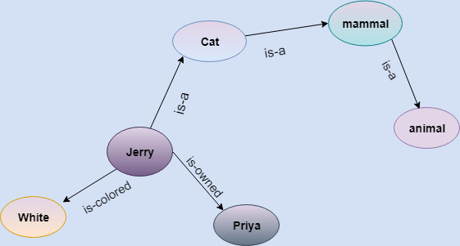
Semantic Network Representation
Example: Following are some statements which we need to represent in the form of nodes and arcs.
Statements:
Jerry is a cat.
Jerry is a mammal
Jerry is owned by Priya.
Jerry is white colored.
All Mammals are animal.

Slide 26
Semantic Network Representation
Advantages of Semantic network:
Semantic networks are a natural representation of knowledge.
Semantic networks convey meaning in a transparent manner.
These networks are simple and easily understandable.

Slide 27
Semantic Network Representation
Drawbacks in Semantic representation:
Semantic networks take more computational time at runtime as we need to traverse the complete network tree to answer some questions. It might be possible in the worst case scenario that after traversing the entire tree, we find that the solution does not exist in this network.
Semantic networks try to model human-like memory to store the information, but in practice, it is not possible to build such a vast semantic network.
These types of representations are inadequate as they do not have any equivalent quantifier, e.g., for all, for some, none, etc.
Semantic networks do not have any standard definition for the link names.
These networks are not intelligent and depend on the creator of the system.

Slide 28
Frames / Frame Representation
A frame is a record like structure which consists of a collection of attributes and its values to describe an entity in the world.
Frames are the AI data structure which divides knowledge into substructures by representing stereotypes situations.
Frame consists of a collection of slots and slot values.
These slots may be of any type and sizes.
Slots have names and values which are called facets.
A frame is also known as slot-filter knowledge representation in artificial intelligence.

Slide 29
Frames / Frame Representation
Example.1: Let's take an example of a frame for a book
Slots | Filters
Title | Artificial Intelligence
Genre | Computer Science
Author | Peter Norvig
Edition | Third Edition
Year | 1996
Page | 1152

Slide 30
Frames / Frame Representation
Example.2: Let's take an example of a frame for an entity, Peter. Peter is an engineer as a profession, and his age is 25, he lives in city London, and the country is England. So following is the frame representation for this:
Slots | Filters
Name | Peter
Profession | Engineer
Age | 25
Marital status | Single
Weight | 78

Slide 31
Frames / Frame Representation
Advantages of frame representation:
The frame knowledge representation makes the programming easier by grouping the related data.
The frame representation is comparably flexible and used by many applications in AI.
It is very easy to add slots for new attribute and relations.
It is easy to include default data and to search for missing values.
Frame representation is easy to understand and visualize.

Slide 32
Frames / Frame Representation
Disadvantages of frame representation:
In frame system inference mechanism is not be easily processed.
Inference mechanism cannot be smoothly proceeded by frame representation.
Frame representation has a much generalized approach.

Slide 33
Script
Script: A script is a structured representation describing a stereotyped sequence of events in a particular context.
Scripts are used in natural language understanding systems to organize a knowledge base in terms of the situations that the system should understand.
Scripts use a frame-like structure to represent the commonly occurring experience like going to the movies eating in a restaurant, shopping in a supermarket, or visiting an ophthalmologist.
Thus, a script is a structure that prescribes a set of circumstances that could be expected to follow on from one another.
Scripts are beneficial because:
Events tend to occur in known runs or patterns.
A casual relationship between events exist.
An entry condition exists which allows an event to take place.
Prerequisites exist upon events taking place.

Slide 34
Script
Components of a script
Entry condition: These are basic condition which must be fulfilled before events in the script can occur.
Results: Condition that will be true after events in script occurred.
Props: Slots representing objects involved in events
Roles: These are the actions that the individual participants perform.
Track: Variations on the script. Different tracks may share components of the same scripts.
Scenes: The sequence of events that occur.

Slide 35
Propositional Logic
Propositional logic (PL) is the simplest form of logic where all the statements are made by propositions.
A proposition is a declarative statement which is either true or false.
It is a technique of knowledge representation in logical and mathematical form.
Example:
It is Sunday.
The Sun rises from West (False proposition)
3+3= 7(False proposition)
5 is a prime number.

Slide 36
Facts about Propositional Logic
Following are some basic facts about propositional logic:
Propositional logic is also called Boolean logic as it works on 0 and 1.
In propositional logic, we use symbolic variables to represent the logic, and we can use any symbol for a representing a proposition, such A, B, C, P, Q, R, etc.
Propositions can be either true or false, but it cannot be both.
Propositional logic consists of an object, relations or function, and logical connectives.
Connectives can be said as a logical operator which connects two sentences.
These connectives are also called logical operators.
The propositions and connectives are the basic elements of the propositional logic.

Slide 37
Facts about Propositional Logic Cntd…
A proposition formula which is always true is called tautology, and it is also called a valid sentence.
A proposition formula which is always false is called Contradiction.
A proposition formula which has both true and false values is called Contingency.
Statements which are questions, commands, or opinions are not propositions such as "Where is Rohini", "How are you", "What is your name", are not propositions.

Slide 38
Syntax of propositional logic
The syntax of propositional logic defines the allowable sentences for the knowledge representation.
There are two types of Propositions:
Atomic Propositions
Compound propositions
Atomic Proposition: Atomic propositions are the simple propositions. It consists of a single proposition symbol. These are the sentences which must be either true or false.
Example:
a) 2+2 is 4, it is an atomic proposition as it is a true fact.
b) "The Sun is cold" is also a proposition as it is a false fact.

Slide 39
Syntax of propositional logic
Compound proposition: Compound propositions are constructed by combining simpler or atomic propositions, using parentheses and logical connectives.
Example:
a) "It is raining today, and street is wet."
b) "Ankit is a doctor, and his clinic is in Mumbai."

Slide 40
Logical Connectives Cntd…
Logical connectives are used to connect two simpler propositions or representing a sentence logically. We can create compound propositions with the help of logical connectives.
There are mainly five connectives, which are given as follows:
Negation: A sentence such as ¬ P is called negation of P. A literal can be either Positive literal or negative literal.
Conjunction: A sentence which has ∧ connective such as, P ∧ Q is called a conjunction. Example: Rohan is intelligent and hardworking. It can be written as, P= Rohan is intelligent, Q= Rohan is hardworking. → P∧ Q.
Disjunction: A sentence which has ∨ connective, such as P ∨ Q. is called disjunction, where P and Q are the propositions. Example: "Ritika is a doctor or Engineer", Here P= Ritika is Doctor. Q= Ritika is Doctor, so we can write it as P ∨ Q.

Slide 41
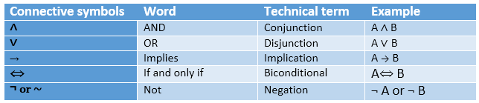
Logical Connectives Cntd…
Implication: A sentence such as P → Q, is called an implication. Implications are also known as if-then rules. It can be represented as If it is raining, then the street is wet. Let P= It is raining, and Q= Street is wet, so it is represented as P → Q
Biconditional: A sentence such as P⇔ Q is a Biconditional sentence,
example If I am breathing, then I am alive P= I am breathing, Q= I am alive, it can be represented as P ⇔ Q.
Following is the summarized table for Propositional Logic Connectives:

Slide 42
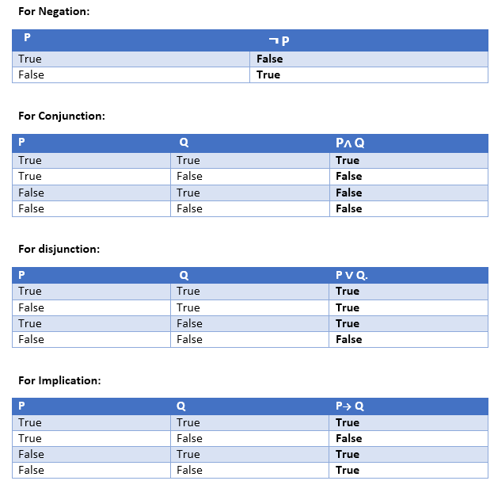
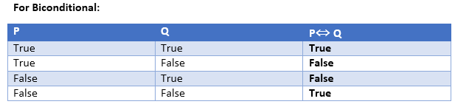
Truth Table

Slide 43
Rules of Inference in AI
Inference:
In artificial intelligence, we need intelligent computers which can create new logic from old logic or by evidence, so generating the conclusions from evidence and facts is termed as Inference.
Inference rules:
Inference rules are the templates for generating valid arguments.
Inference rules are applied to derive proofs in artificial intelligence, and the proof is a sequence of the conclusion that leads to the desired goal.
Following are some terminologies related to inference rules:
Implication: It is one of the logical connectives which can be represented as P → Q. It is a Boolean expression.
Converse: The converse of implication, which means the right-hand side proposition goes to the left-hand side and vice-versa. It can be written as Q → P.
Contrapositive: The negation of converse is termed as contrapositive, and it can be represented as ¬ Q → ¬ P.
Inverse: The negation of implication is called inverse. It can be represented as ¬ P → ¬ Q.

Slide 44
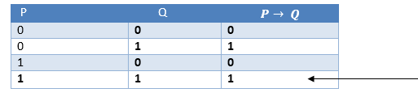
Types of Inference rules
1. Modus Ponens
The Modus Ponens rule is one of the most important rules of inference, and it states that if P and P → Q is true, then we can infer that Q will be true. It can be represented as:
Example:
Statement-1: "If I am sleepy then I go to bed" ==> P→ Q
Statement-2: "I am sleepy" ==> P
Conclusion: "I go to bed." ==> Q.
Hence, we can say that, if P→ Q is true and P is true then Q will be true.
Proof by Truth table:

Slide 45
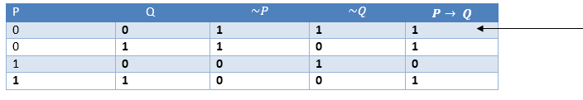
Types of Inference rules
2. Modus Tollens
The Modus Tollens rule state that if P→ Q is true and ¬ Q is true, then ¬ P will also true. It can be represented as:
Example:
Statement-1: "If I am sleepy then I go to bed" ==> P→ Q
Statement-2: "I do not go to the bed."==> ~Q
Statement-3: Which infers that "I am not sleepy" => ~P
Proof by Truth table:

Slide 46

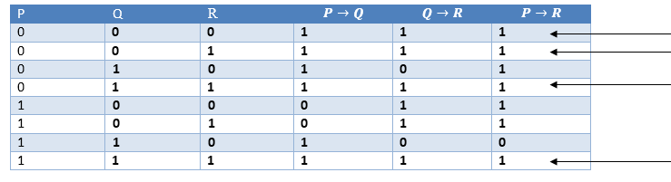
Types of Inference rules
3. Hypothetical Syllogism
The Hypothetical Syllogism rule state that if P→R is true whenever P→Q is true, and Q→R is true. It can be represented as the following notation:
Example:
Statement-1: If you have my home key then you can unlock my home. P→Q
Statement-2: If you can unlock my home then you can take my money. Q→R
Conclusion: If you have my home key then you can take my money. P→R
Proof by Truth table:

Slide 47
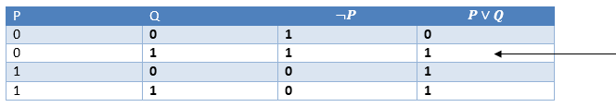
Types of Inference rules
4. Disjunctive Syllogism
The Disjunctive syllogism rule state that if P∨Q is true, and ¬P is true, then Q will be true. It can be represented as:
Example:
Statement-1: Today is Sunday or Monday. ==>P∨Q
Statement-2: Today is not Sunday. ==> ¬P
Conclusion: Today is Monday. ==> Q
Proof by Truth table:

Slide 48
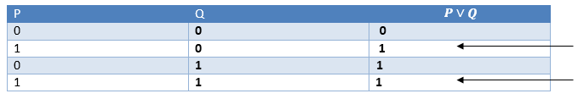
Types of Inference rules
5. Addition
The Addition rule is one the common inference rule, and it states that If P is true, then P∨Q will be true. It can be represented as:
Example:
Statement: I have a vanilla ice-cream. ==> P
Statement-2: I have Chocolate ice-cream.
Conclusion: I have vanilla or chocolate ice-cream. ==> (P∨Q)
Proof by Truth table:

Slide 49
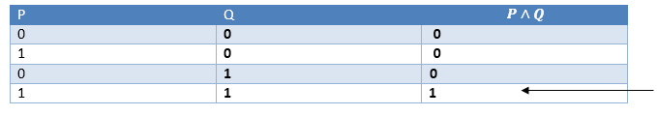
Types of Inference rules
6. Simplification
The simplification rule state that if P∧ Q is true, then Q or P will also be true. It can be represented as:
Proof by Truth table:

Slide 50
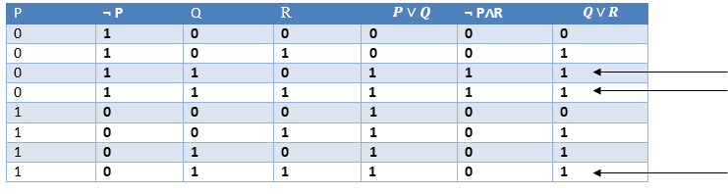
Types of Inference rules
7. Resolution
The Resolution rule state that if P∨Q and ¬ P∧R is true, then Q∨R will also be true. It can be represented as:
Proof by Truth table:

Slide 51


Propositional Logic: The Wumpus World Problem
Stench |  | Breeze | PIT
 | Stench | PIT | Breeze
 | Breeze
 | Gold
Stench |  | Breeze
Start | Breeze | PIT | Breeze
Rules:
The rooms adjacent to WUMPUS are SMELLY (STENCH)
The rooms adjacent to PIT has BREEZE.
There will be a GLITTER in the room iff there is GOLD present.
The Wumpus can be killed by the agent if the agent is facing to it, and Wumpus will emit a horrible scream which can be heard anywhere in the cave.

Slide 52
PEAS description of Wumpus world
Performance measure:
+1000 reward points if the agent comes out of the cave with the gold.
-1000 points penalty for being eaten by the Wumpus or falling into the pit.
-1 for each action, and -10 for using an arrow.
The game ends if either agent dies or came out of the cave.
Environment:
A 4*4 grid of rooms.
The agent initially in room square [1, 1], facing toward the right.
Location of Wumpus and gold are chosen randomly except the first square [1,1].
Each square of the cave can be a pit with probability 0.2 except the first square.

Slide 53
PEAS description of Wumpus world
Actuators:
Left turn,
Right turn
Move forward
Grab
Release
Shoot.

Slide 54
PEAS description of Wumpus world
Sensors:
The agent will perceive the stench if he is in the room adjacent to the Wumpus. (Not diagonally).
The agent will perceive breeze if he is in the room directly adjacent to the Pit.
The agent will perceive the glitter in the room where the gold is present.
The agent will perceive the bump if he walks into a wall.
When the Wumpus is shot, it emits a horrible scream which can be perceived anywhere in the cave.
These percepts can be represented as five element list, in which we will have different indicators for each sensor.
Example if agent perceives stench, breeze, but no glitter, no bump, and no scream then it can be represented as: [Stench, Breeze, None, None, None].

Slide 55
Properties of Wumpus world
Partially observable: The Wumpus world is partially observable because the agent can only perceive the close environment such as an adjacent room.
Deterministic: It is deterministic, as the result and outcome of the world are already known.
Sequential: The order is important, so it is sequential.
Static: It is static as Wumpus and Pits are not moving.
Discrete: The environment is discrete.
One agent: The environment is a single agent as we have one agent only and Wumpus is not considered as an agent.

Slide 56
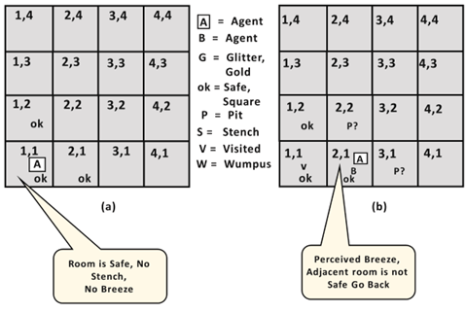
The Agents Steps
Step 1 & 2

Slide 57
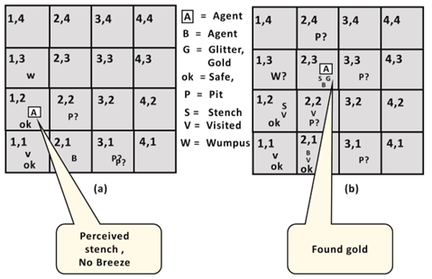
The Agents Steps
Step 3 & 4

Slide 58
Knowledge-base for Wumpus world
Atomic proposition variable for Wumpus world:
Let P_{i,j} be true if there is a Pit in the room [i, j].
Let B_{i,j} be true if agent perceives breeze in [i, j], (dead or alive).
Let W_{i,j} be true if there is wumpus in the square[i, j].
Let S_{i,j} be true if agent perceives stench in the square [i, j].
Let V_{i,j} be true if that square[i, j] is visited.
Let G_{i,j} be true if there is gold (and glitter) in the square [i, j].
Let OK_{i,j} be true if the room is safe

Slide 59
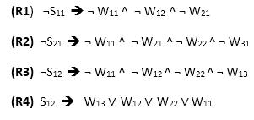
Knowledge-base for Wumpus world
B = Breeze | A = Agent | G = Glitter | P = Pit | S = Stench | OK = Safe | V = Visited | W = Wampus
Some Propositional Rules for the wumpus world:
1,4 S | 2,4 | 3,4 B | 4,4 P
1,3 W | 2,3 S, B, G | 3,3 P | 4,3 B
1,2 S | 2,2 | 3,2 B | 4,2
1,1 | 2,1 B | 3,1 P | 4,1 B

Slide 60

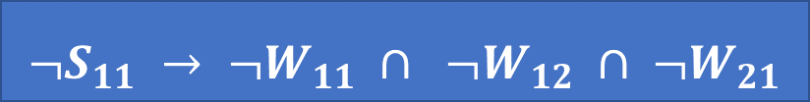


Propositional Logic: The Wumpus World Problem
Apply And-Elimination Rule:After applying And-elimination rule to ¬ W₁₁ ∧ ¬ W₁₂ ∧ ¬ W₂₁, we will get three statements: ¬ W₁₁, ¬ W₁₂, and ¬W₂₁.

Slide 61



Propositional Logic: The Wumpus World Problem
Apply And-Elimination Rule:Now again apply And-elimination rule to ¬ W11 ¬ W21 ∧ ¬ W22 ∧¬ W31, We will get three statements: ¬ W11 ¬ W21, ¬ W22, and ¬ W31.

Slide 62



Propositional Logic: The Wumpus World Problem

Slide 63



Propositional Logic: The Wumpus World Problem
Note- Unit Resolution: The resolution inference rule takes two premises in the form of clauses (A ∨ x) and (B ∨ ¬x) and gives the clause (A ∨ B) as a conclusion. The two premises are said to be resolved and the variable x is said to be resolved away. Resolving the two clauses x and x gives the empty clause.

Slide 64

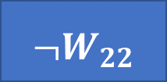

Propositional Logic: The Wumpus World Problem

Slide 65



Propositional Logic: The Wumpus World Problem
Hence it is proved that the Wumpus is in the room [1, 3].

Slide 66
Foundations of Knowledge Representation and Reasoning
The earliest work in computerized knowledge representation was focused on general problem-solvers such as the General Problem Solver (GPS) system developed by Allen Newell and Herbert A. Simon in 1959.
These systems featured data structures for planning and decomposition.
The system would begin with a goal. It would then decompose that goal into subgoals and then set out to construct strategies that could accomplish each subgoal.
In these early days of AI, general search algorithms such as A* were also developed. However, the amorphous problem definitions for systems such as GPS meant that they worked only for very constrained toy domains (e.g. the "blocks world").
In order to tackle non-toy problems, AI researchers such as Ed Feigenbaum and Frederick Hayes-Roth realized that it was necessary to focus systems on more constrained problems.

Slide 67
Foundations of Knowledge Representation and Reasoning Cntd…
These efforts led to the cognitive revolution in psychology and to the phase of AI focused on knowledge representation that resulted in expert systems in the 1970s and 80s, production systems, frame languages, etc.
Rather than general problem solvers, AI changed its focus to expert systems that could match human competence on a specific task, such as medical diagnosis.
Expert systems gave us the terminology still in use today where AI systems are divided into a knowledge base, with facts about the world and rules, and an inference engine, which applies the rules to the knowledge base in order to answer questions and solve problems.
In these early systems the knowledge base tended to be a fairly flat structure, essentially assertions about the values of variables used by the rule

Slide 68
Foundations of Knowledge Representation and Reasoning Cntd…
In 1993 a key paper on the topic, Randall Davis of MIT outlined five distinct roles to analyze a knowledge representation framework:
A knowledge representation (KR) is most fundamentally a surrogate, a substitute for the thing itself, used to enable an entity to determine consequences by thinking rather than acting, i.e., by reasoning about the world rather than taking action in it.
It is a set of ontological commitments, i.e., an answer to the question: In what terms should I think about the world?
It is a fragmentary theory of intelligent reasoning, expressed in terms of three components:
(i) the representation's fundamental conception of intelligent reasoning;
(ii) the set of inferences the representation sanctions; and
(iii) the set of inferences it recommends.

Slide 69
Foundations of Knowledge Representation and Reasoning Cntd…
It is a medium for pragmatically efficient computation, i.e., the computational environment in which thinking is accomplished.
One contribution to this pragmatic efficiency is supplied by the guidance a representation provides for organizing information so as to facilitate making the recommended inferences.
It is a medium of human expression, i.e., a language in which we say things about the world.

Slide 70
Why First Order Logic (FOL)
In propositional logic, we can only represent the facts, which are either true or false.
PL is not sufficient to represent the complex sentences or natural language statements.
The propositional logic has very limited expressive power.
Consider the following sentence, which we cannot represent using PL logic.
"Some humans are intelligent", or
"Sachin likes cricket."
To represent the above statements, PL logic is not sufficient, so we required some more powerful logic, such as first-order logic.

Slide 71
First Order Logic
FOL is a mode of representation in AI. It is an extension of PL.
It represents natural language statements in a concise way.
It is also known as Predicate logic or First-order predicate logic.
It is a powerful language that develops information about the objects in a more easy way and can also express the relationship between those objects.
FOL (like natural language) does not only assume that the world contains facts like propositional logic but also assumes the following things in the world:
Objects: A, B, people, numbers, colors, wars, theories, squares, pits, wumpus, ......
Relations: It can be unary relation such as: red, round, is adjacent, or n-any relation such as: the sister of, brother of, has color, comes between
Function: Father of, best friend, third inning of, end of, ......

Slide 72
First Order Logic cntd…
As a natural language, first-order logic also has two main parts:
Syntax
Semantics
Syntax of First-Order logic
In prepositional logic, every expression is a sentence that represents a fact.
First order logic includes the sentences along with terms which can represent the objects.
Constant symbols, variables and function symbols are used to build terms, while quantifiers and predicate symbols are used to build the sentences.

Slide 73
First Order Logic cntd…
Basic elements of FOL
Name | Symbol
Constant | 1, 6, A,W,New York, Elie, Dog...
Variables | a, b, c, x, y, z...
Predicates | <, >, brother, sister, father...
Equality | ==
Function | Sqrt, LessThan, Sin(θ)...
Quantifier | ∀, ∃
Connectives | ∧, ∨, ¬, ⇒, ⇔

Slide 74
First Order Logic: Defining a Sentence
Atomic sentences:
Atomic sentences are the most basic sentences of first-order logic. These sentences are formed from a predicate symbol followed by a parenthesis with a sequence of terms.
We can represent atomic sentences as Predicate (term1, term2, ......, term n).
Example: Ravi and Ajay are brothers: => Brothers(Ravi, Ajay).
German Shepherd is a dog → Dog (German Shepherd).
Complex Sentences:
Complex sentences are made by combining atomic sentences using connectives.

Slide 75
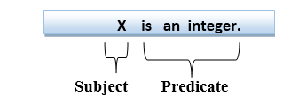
First Order Logic: Defining a Sentence
First-order logic statements can be divided into two parts:
Subject: Subject is the main part of the statement.
Predicate: A predicate can be defined as a relation, which binds two atoms together in a statement.
Consider the statement: "x is an integer.", it consists of two parts, the first part x is the subject of the statement and second part "is an integer," is known as a predicate.

Slide 76
First Order Logic: Quantifiers in Predicate Calculus
A quantifier is a language element which generates quantification, and quantification specifies the quantity of specimen in the universe of discourse.
These are the symbols that permit to determine or identify the range and scope of the variable in the logical expression. There are two types of quantifier:
Universal Quantifier, (for all, everyone, everything)
Existential quantifier, (for some, at least one).
Universal Quantifier:
Universal quantifier is a symbol of logical representation, which specifies that the statement within its range is true for everything or every instance of a particular thing.
The Universal quantifier is represented by a symbol ∀, which resembles an inverted A.

Slide 77
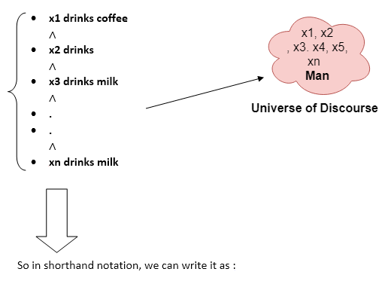
First Order Logic: Quantifiers in Predicate Calculus
Universal Quantifier cntd…:
If x is a variable, then ∀x is read as:
For all x
For each x
For every x.
Example:
All man drink coffee.
Let a variable x which refers to a man so all x can be represented in UOD as shown in diagram:
∀x man(x) → drink (x, coffee).
It will be read as: There are all x where x is a man who drink coffee.

Slide 78
First Order Logic: Quantifiers in Predicate Calculus
Existential Quantifier :
Existential quantifiers are the type of quantifiers, which express that the statement within its scope is true for at least one instance of something.
It is denoted by the logical operator ∃, which resembles as inverted E. When it is used with a predicate variable then it is called as an existential quantifier.
If x is a variable, then existential quantifier will be ∃x or ∃(x). And it will be read as:
There exists a 'x.'
For some 'x.'
For at least one 'x.'

Slide 79
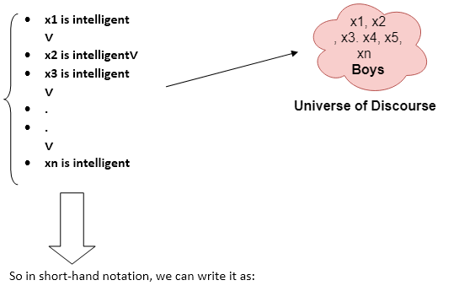
First Order Logic: Quantifiers in Predicate Calculus
Existential Quantifier cntd… :
Example: Some boys are intelligent.
∃x: boys(x) ∧ intelligent(x)
It will be read as: There are some x where x is a boy who is intelligent

Slide 80
First Order Logic: Quantifiers in Predicate Calculus
Points to remember :
The main connective for universal quantifier ∀ is implication →.
The main connective for existential quantifier ∃ is and ∧.
Properties of Quantifiers:
In universal quantifier, ∀x∀y is similar to ∀y∀x.
In Existential quantifier, ∃x∃y is similar to ∃y∃x.
∃x∀y is not similar to ∀y∃x.

Slide 81
First Order Logic: Quantifiers in Predicate Calculus
Some Examples of FOL using quantifier :
1. All birds fly.
In this question the predicate is "fly(bird)." And since there are all birds who fly so it will be represented as follows.
∀x bird(x) →fly(x).
2. Every man respects his parent.
In this question, the predicate is "respect(x, y)," where x=man, and y= parent. Since there is every man so will use ∀, and it will be represented as follows:
∀x man(x) → respects (x, parent).
3. Some boys play cricket.
In this question, the predicate is "play(x, y)," where x= boys, and y= game. Since there are some boys so we will use ∃, and it will be represented as:
∃x boys(x) → play(x, cricket).

Slide 82
First Order Logic: Quantifiers in Predicate Calculus
Some Examples of FOL using quantifier cntd… :
4. Not all students like both Mathematics and Science.
In this question, the predicate is "like(x, y)," where x= student, and y= subject. Since there are not all students, so we will use ∀ with negation, so following representation for this:
¬∀ (x) [ student(x) → like(x, Mathematics) ∧ like(x, Science)].
5. Only one student failed in Mathematics.
In this question, the predicate is "failed(x, y)," where x= student, and y= subject. Since there is only one student who failed in Mathematics, so we will use following representation for this:
∃(x) [ student(x) → failed (x, Mathematics) ∧∀ (y) [¬(x==y) ∧ student(y) → ¬failed (x, Mathematics)].

Slide 83
Knowledge Engineering in First Order Logic
A knowledge engineer is someone who investigates a particular domain, learns what concepts are important in that domain, and creates a formal representation of the objects and relations in the domain.
The knowledge-engineering process include following steps
1. Identify the task
2. Assemble the relevant knowledge
3. Decide on a vocabulary of predicates, functions, and constants
4. Encode general knowledge about the domain
5. Encode a description of the specific problem instance
6. Pose queries to the inference procedure and get answers
7. Debug the knowledge base

Slide 84
Knowledge Engineering in First Order Logic
1. Identify the task
The knowledge engineer must precisely describe the range of questions that the knowledge base will support and the kinds of facts that will be available for each specific problem instance.
For example, does the wumpus knowledge base need to be able to choose actions or is it required to answer questions only about the contents of the environment? Will the sensor facts include the current location?
The task will determine what knowledge must be represented in order to connect problem instances to answers.
This step is analogous to the PEAS process for designing agents.

Slide 85
Knowledge Engineering in First Order Logic
2. Assemble the relevant knowledge
The knowledge engineer might already be an expert in the domain, or might need to work with real experts to extract what they know—a process called knowledge acquisition.
At this stage, the knowledge is not represented formally.
The idea is to understand the scope of the knowledge base, as determined by the task, and to understand how the domain actually works.
For the wumpus world, which is defined by an artificial set of rules, the relevant knowledge is easy to identify.

Slide 86
Knowledge Engineering in First Order Logic
3. Decide on a vocabulary of predicates, functions, and constants
Translate the important domain-level concepts into logic-level names.
This involves many questions of knowledge-engineering style.
For example, should pits be represented by objects or by a unary predicate on squares?
Should the agent’s orientation be a function or a predicate?
Should the wumpus’s location depend on time?
Once the choices have been made, the result is a vocabulary that is known as the ontology of the domain
4. Encode general knowledge about the domain
The knowledge engineer writes down the axioms for all the vocabulary terms.
This pins down (to the extent possible) the meaning of the terms, enabling the expert to check the content.
Often, this step reveals misconceptions or gaps in the vocabulary that must be fixed by returning to step 3 and iterating through the process

Slide 87
Knowledge Engineering in First Order Logic
5. Encode a description of the specific problem instance
If the ontology is well thought out, this step will be easy.
It will involve writing simple atomic sentences about instances of concepts that are already part of the ontology.
For a logical agent, problem instances are supplied by the sensors, whereas a “disembodied” knowledge base is supplied with additional sentences in the same way that traditional programs are supplied with input data.
6. Pose queries to the inference procedure and get answers
This is where the reward is: we can let the inference procedure operate on the axioms and problem-specific facts to derive the facts we are interested in knowing.
Thus, we avoid the need for writing an application-specific solution algorithm.

Slide 88
Knowledge Engineering in First Order Logic
7. Debug the knowledge base
Unfortunately the answers to queries will seldom be correct on the first try.
More precisely, the answers will be correct for the knowledge base as written, assuming that the inference procedure is sound, but they will not be the ones that the user is expecting.
For example, if an axiom is missing, some queries will not be answerable from the knowledge base.
A considerable debugging process could happen later.
Missing axioms or axioms that are too weak can be easily identified by noticing places where the chain of reasoning stops unexpectedly.
For example, if the knowledge base includes a diagnostic rule for finding the wumpus,
∀ s Smelly(s) ⇒ Adjacent(Home(Wumpus), s) ,
instead of the biconditional, then the agent will never be able to prove the absence of wumpuses

Slide 89
Situation Calculus - Introduction
Situation calculus is used for planning by asking for a situation in which a goal is true. Answer extraction is used to find a situation in which the goal is true.
This situation can be interpreted as a sequence of actions for the agent to perform.
The situation calculus is a logic formalism designed for representing and reasoning about dynamical domains. It was first introduced by John McCarthy in 1963. The main version of the situational calculus that is presented in this article is based on that introduced by Ray Reiter in 1991.
The main elements of the situation calculus are the actions, fluents and the situations.
A number of objects are also typically involved in the description of the world.
The situation calculus is based on a sorted domain with three sorts: actions, situations, and objects, where the objects include everything that is not an action or a situation.
Variables of each sort can be used. While actions, situations, and objects are elements of the domain, the fluents are modeled as either predicates or functions.

Slide 90
Situation Calculus - Introduction cntd…
Actions: The actions form a sort of the domain. Variables of sort action can be used. Actions can be quantified.
Situations: In the situation calculus, a dynamic world is modeled as progressing through a series of situations as a result of various actions being performed within the world. A situation represents a history of action occurrences.
Fluents: Statements whose truth value may change are modeled by relational fluents, predicates which take a situation as their final argument. Functional fluents are functions which take a situation as their final argument and return a situation-dependent value.

Slide 91
Situation Calculus - Introduction cntd…
In the modern version of the situational calculus, a situation is a sequence of actions.
Originally, situations were defined as “the complete state of the universe at an instant of time”.
It was clear from the beginning that such situations could not be completely described; the idea was simply to give some statements about situations, and derive consequences from them.
This is also different from the approach that is taken by the fluent calculus, where a state can be a collection of known facts, that is, a possibly incomplete description of the universe.

Slide 92
Problems with FOL
The syntax of FOL is designed to make it easy to say things about objects but finding problem solution using FOL is computationally expensive
FOL is Undecidable(Semi-decidable)
We can use frames where we keep all related data together
But frame lack in logic basis
So we can think of Description Logics(DL) which is subset of FOL and decidable and computationally inexpensive
DLs are family of languages used in artificial intelligence to describe and reason about the relevant concepts of an application domain (known as terminological knowledge).

Slide 93
Description Logics
Description logics (DL) are a family of formal knowledge representation languages. Many DLs are more expressive than propositional logic but less expressive than first-order logic.
In contrast to first order logic, the core reasoning problems for DLs are (usually) decidable, and efficient decision procedures have been designed and implemented for these problems.
There are general, spatial, temporal, spatiotemporal, and fuzzy description logics, and each description logic features a different balance between expressive power and reasoning complexity by supporting different sets of mathematical constructors.
DLs are used to describe the set of concepts.
The fundamental modeling concept of a DL is the axiom - a logical statement relating roles and/or concepts.
Def: DL are notations that are designed to make it easier to describe definitions and properties of categories.

Slide 94
Description Logics
Concepts / categories
. .
mortal
Doman D contains individuals
man

Slide 95
Description Logics cntd…
In FOL we say ∀ x man(x) ⇒ mortal(x)
In DL we say man ⊆ mortal (No quantifiers and variables used)
A description logic (DL) models concepts, roles and individuals, and their relationships.
concepts: {c,d,....}
roles:{binary relations such as father, mother and so on represented with r, s……}
individuals: {a,b,....}
The Principal Inference tasks:
Subsumption - checking if one category is a subset of another by comparing their definitions
Classification - checking whether an object belongs to a category

Slide 96
Description Logics example: CLASSIC Language
The syntax of descriptions in a subset of the CLASSIC language
Concept → Thing | ConceptName
| And (Concept,…)
| All (RoleName, Concept)
| AtLeast (Integer, RoleName)
| AtMost (Integer, RoleName)
| Fills (RoleName, IndividualName, …)
| SameAs (Path, Path)
| OneOf (IndividualName, …)
Path → [RoleName, …]

Slide 97
Description Logics example: CLASSIC Language
For example, to say that bachelors are unmarried adult males we would write
Bachelor = And(Unmarried, Adult, Male) .
The equivalent in first-order logic would be
Bachelor (x) ⇔ Unmarried(x) ∧ Adult(x) ∧ Male(x) .
Any description in CLASSIC can be translated into an equivalent first-order sentence, but some descriptions are more straightforward in CLASSIC.
For example, to describe the set of men with at least three sons who are all unemployed and married to doctors, and at most two daughters who are all professors in physics or math departments, we would use
And(Man, AtLeast(3, Son), AtMost(2, Daughter ), All(Son, And(Unemployed, Married, All(Spouse, Doctor ))), All(Daughter , And(Professor ,Fills(Department,Physics, Math))))

Slide 98
Description Logics example: CLASSIC Language
The most important aspect of description logics is their emphasis on tractability of inference.
A problem instance is solved by describing it and then asking if it is subsumed by one of several possible solution categories.
DLs ensure that subsumption-testing can be solved in time polynomial in the size of the descriptions.
It can only have one of two consequences:
either hard problems cannot be stated at all, or
they require exponentially large descriptions

Slide 99
Reasoning with Default Information
Let’s first understand
Monotonic Reasoning
Non-monotonic Reasoning
Monotonic Reasoning
Once the conclusion is taken, then it will remain the same even if we add some other information to existing information in our knowledge base.
Decisions are not affected by new facts, and is not useful for the real-time systems, as in real time, facts get changed, so we cannot use monotonic reasoning.
Monotonic reasoning is used in conventional reasoning systems, and a logic-based system is monotonic.
Any theorem proving is an example of monotonic reasoning.

Slide 100
Reasoning with Default Information
Example: Earth revolves around the Sun.
It is a true fact, and it cannot be changed even if we add another sentence in knowledge base like, "The moon revolves around the earth" Or "Earth is not round," etc.
Advantages of Monotonic Reasoning:
In monotonic reasoning, each old proof will always remain valid.
If we deduce some facts from available facts, then it will remain valid for always.
Disadvantages of Monotonic Reasoning:
We cannot represent the real world scenarios using Monotonic reasoning.
Hypothesis knowledge cannot be expressed with monotonic reasoning, which means facts should be true.
Since we can only derive conclusions from the old proofs, so new knowledge from the real world cannot be added.

Slide 101
Reasoning with Default Information
Non-monotonic Reasoning
In Non-monotonic reasoning, some conclusions may be invalidated if we add some more information to our knowledge base.
Logic will be said as non-monotonic if some conclusions can be invalidated by adding more knowledge into our knowledge base.
Non-monotonic reasoning deals with incomplete and uncertain models.
"Human perceptions for various things in daily life, "is a general example of non-monotonic reasoning.
Example: Let suppose the knowledge base contains the following knowledge:
Birds can fly
Penguins cannot fly
Alex is a bird
So from the above sentences, we can conclude that Alex can fly.

Slide 102
Reasoning with Default Information
However, if we add one another sentence into knowledge base "Alex is a penguin", which concludes "Alex cannot fly", so it invalidates the above conclusion.
Advantages of Non-monotonic reasoning:
For real-world systems such as Robot navigation, we can use non-monotonic reasoning.
In Non-monotonic reasoning, we can choose probabilistic facts or can make assumptions.
Disadvantages of Non-monotonic Reasoning:
In non-monotonic reasoning, the old facts may be invalidated by adding new sentences.
It cannot be used for theorem proving.

Slide 103
Reasoning with Default Information
Two logics studied extensively under Nonmonotonic Logics are:
Circumscription
Default Logic
Circumscription
It can be seen as a more powerful and precise version of the closed-world assumption.
The idea is to specify particular predicates that are assumed to be “as false as possible”—that is, false for every object except those for which they are known to be true.
For example, suppose we want to assert the default rule that birds fly.
We would introduce a predicate, say Abnormal₁(x), and write
Bird(x) ∧ ¬Abnormal₁(x) ⇒ Flies(x).
If we say that Abnormal₁ is to be circumscribed, a circumscriptive reasoner is entitled to assume ¬Abnormal₁(x) unless Abnormal₁(x) is known to be true.
This allows the conclusion Flies(Tweety) to be drawn from the premise Bird(Tweety), but the conclusion no longer holds if Abnormal₁(Tweety) is asserted.

Slide 104
Reasoning with Default Information
Default logic
It is a non-monotonic logic proposed by Raymond Reiter to formalize reasoning with default assumptions.
Default reasoning is a form of nonmonotonic reasoning where plausible conclusions are inferred based on general rules which may have exceptions (defaults).
Default logic can express facts like “by default, something is true”; by contrast, standard logic can only express that something is true or that something is false. This is a problem because reasoning often involves facts that are true in the majority of cases but not always.
A classical example is: “birds typically fly”. This rule can be expressed in standard logic either by “all birds fly”, which is inconsistent with the fact that penguins do not fly, or by “all birds that are not penguins and not ostriches and ... fly”, which requires all exceptions to the rule to be specified.
Default logic aims at formalizing inference rules like this one without explicitly mentioning all their exceptions.

Slide 105
Reasoning with Default Information cntd…
It is nonmonotonic in the sense that additional information may force us to withdraw earlier conclusions, namely whenever the additional information shows that the case at hand is exceptional.
We often draw plausible conclusions based on general rules expressing what normally is the case together with the assumption that the world about which we reason is normal and as expected.
This is the best we can do in situations in which we have only incomplete information.
However, it can happen that our normality assumptions turn out to be wrong. New information can show that the situation actually is abnormal in some respect.
Rules can nevertheless be given for default inferences, and a semantics can be developed for them.

Slide 106
Reasoning with Default Information
Generally a default rule looks like:
A : B / C (Read as “If A is provable and It is consistent to assume B then conclude C)
Example:
Bird(x) : Flies(x)/Flies(x) .
This rule means that if Bird(x) is true, and if Flies(x) is consistent with the knowledge base, then Flies(x) may be concluded by default.
In general, a default rule has the form
P : J1,...,Jn /C
where P is called the prerequisite, C is the conclusion, and J_{i} are the justifications—if any one of them can be proven false, then the conclusion cannot be drawn.

Slide 107


